Slide 1
Comparison Of cucumber plots from transplanting to harvest
Location: Shaki Farm– Achituv
Company: Hydrological Israel
Date: 23/5/2013

Slide 2
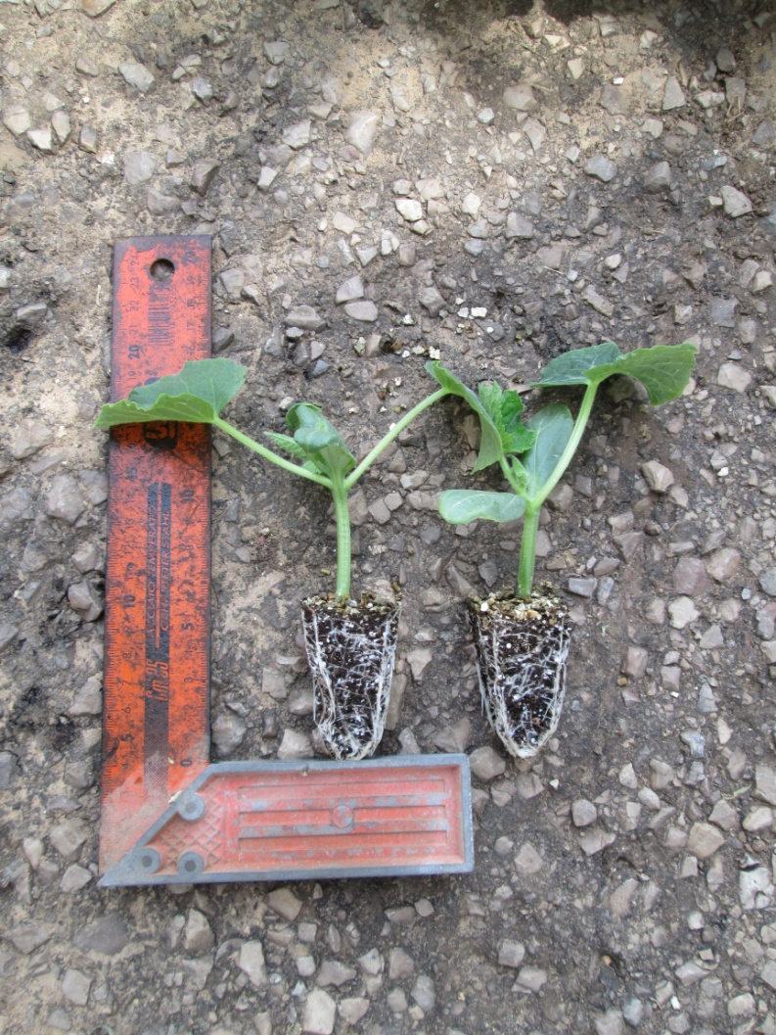
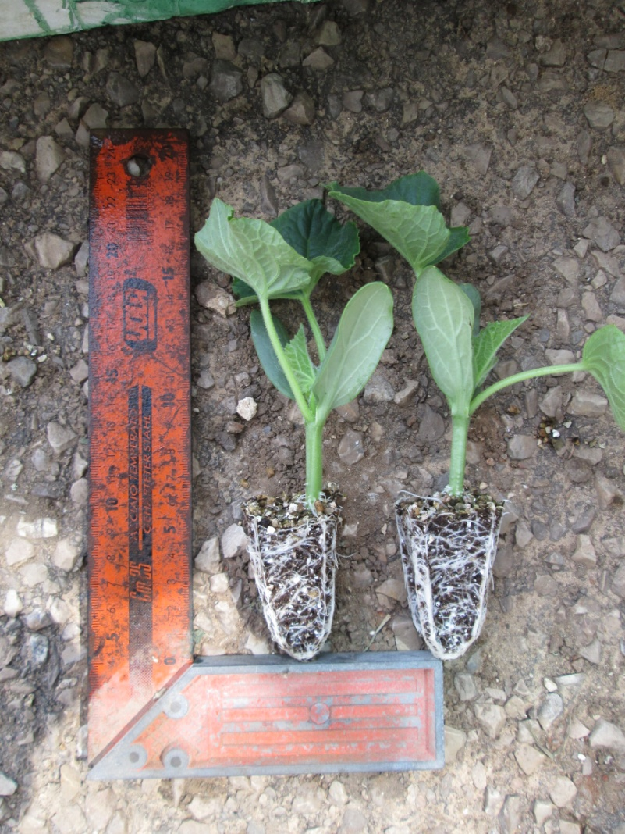
TRANSPLANTING
Saiseiko SEM Series
Control

Slide 3
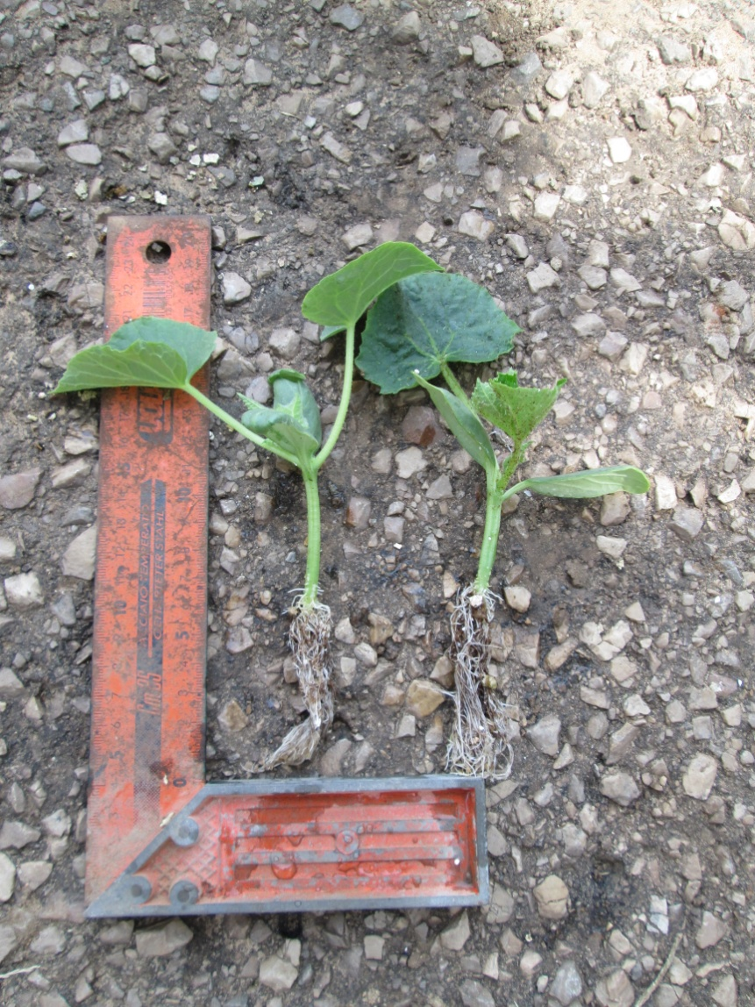
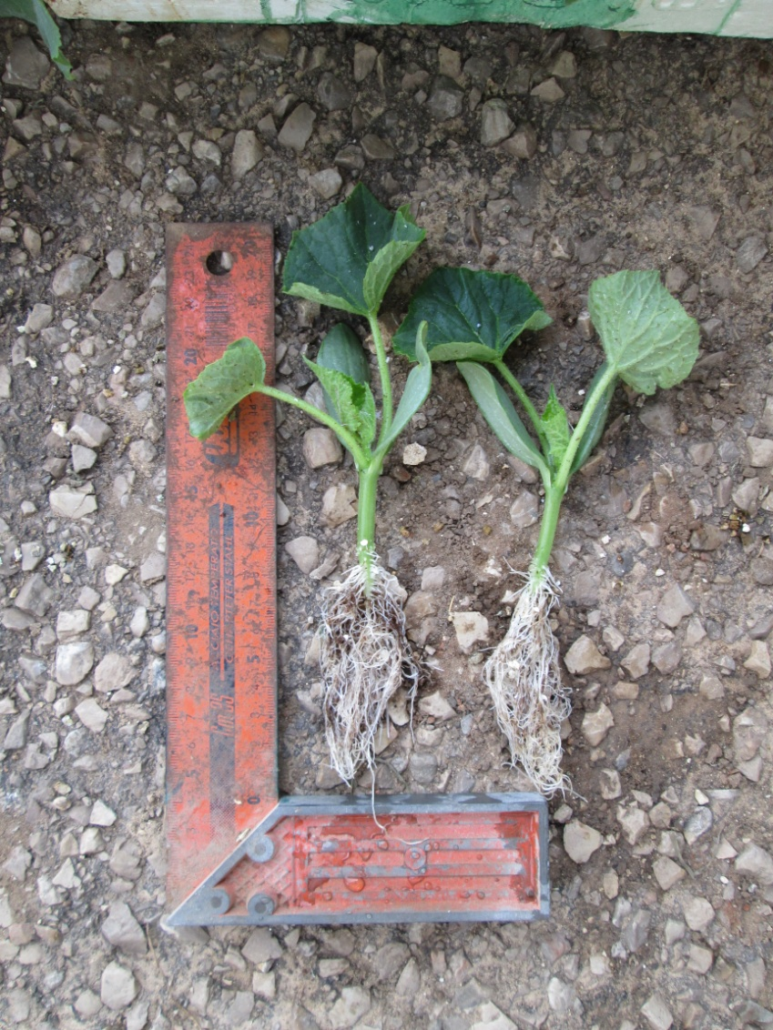
TRANSPLANTING
Saiseiko SEM Series
Control

Slide 4
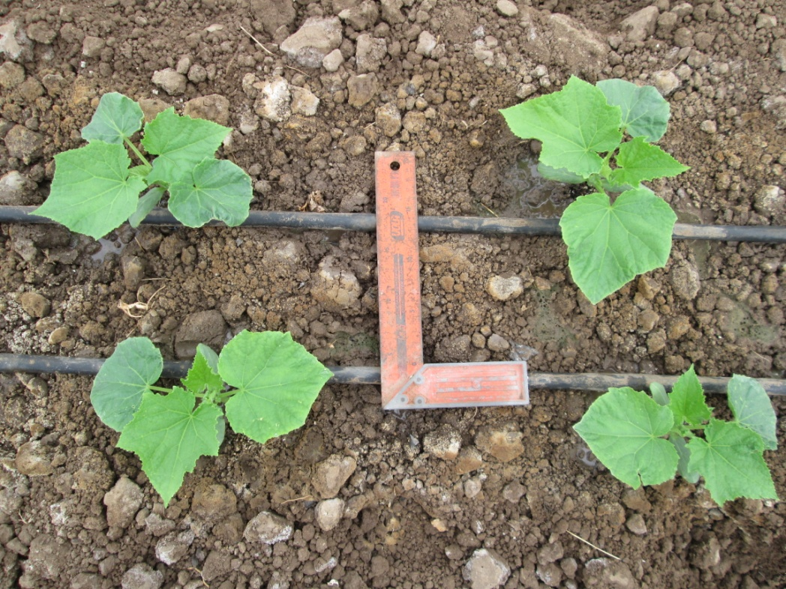
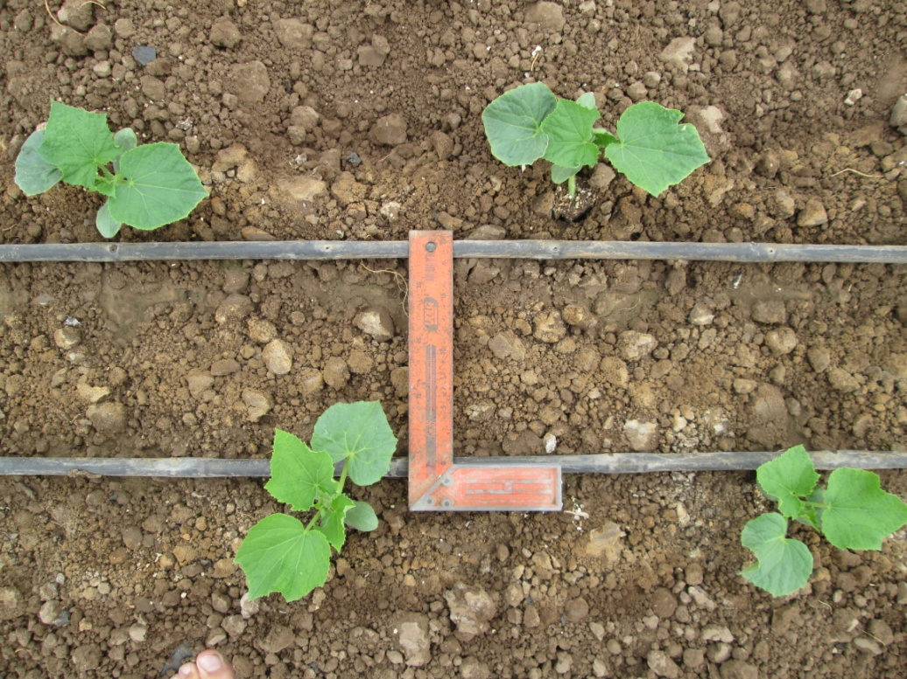
ONE WEEK AFTER TRANSPLANTING
Saiseiko SEM Series
Control

Slide 5
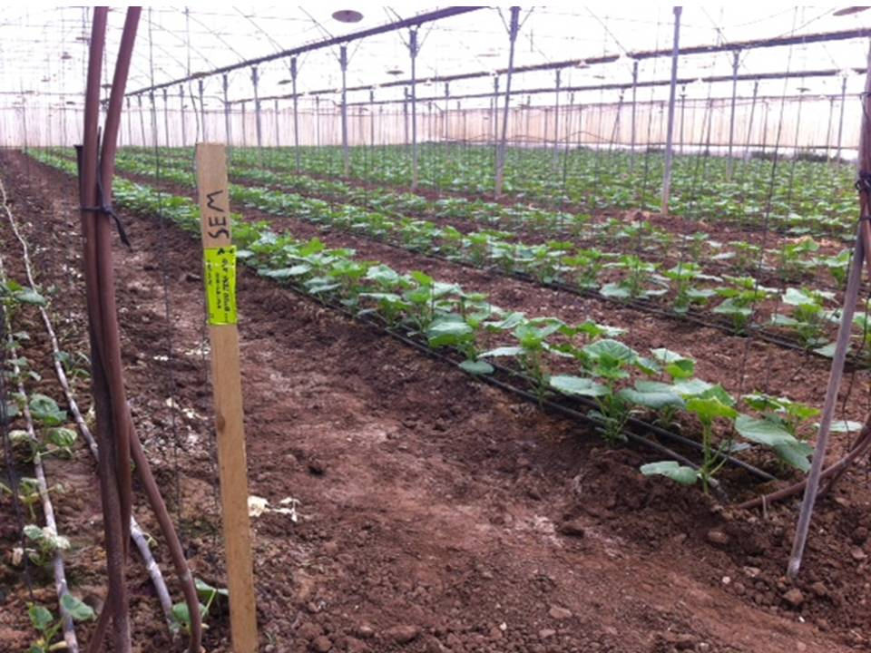
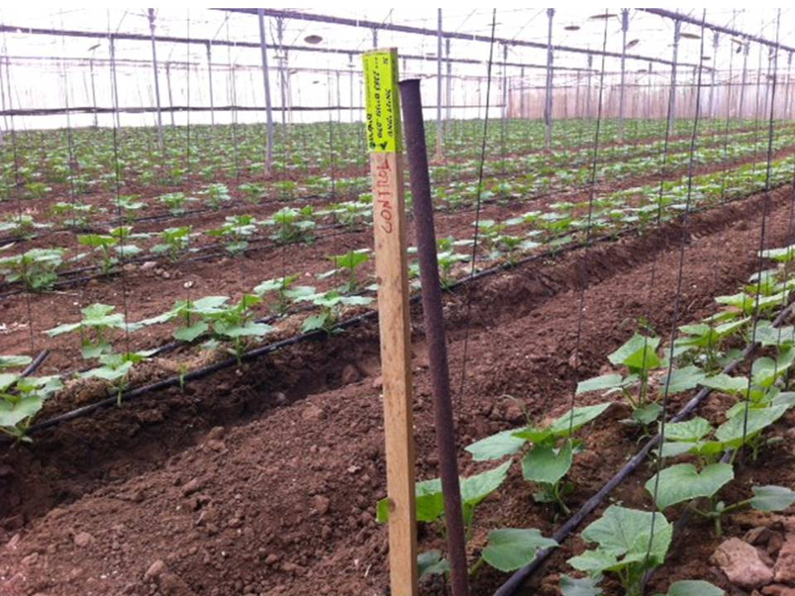
TWO WEEKS AFTER TRANSPLANTING
Saiseiko SEM Series
Control

Slide 6
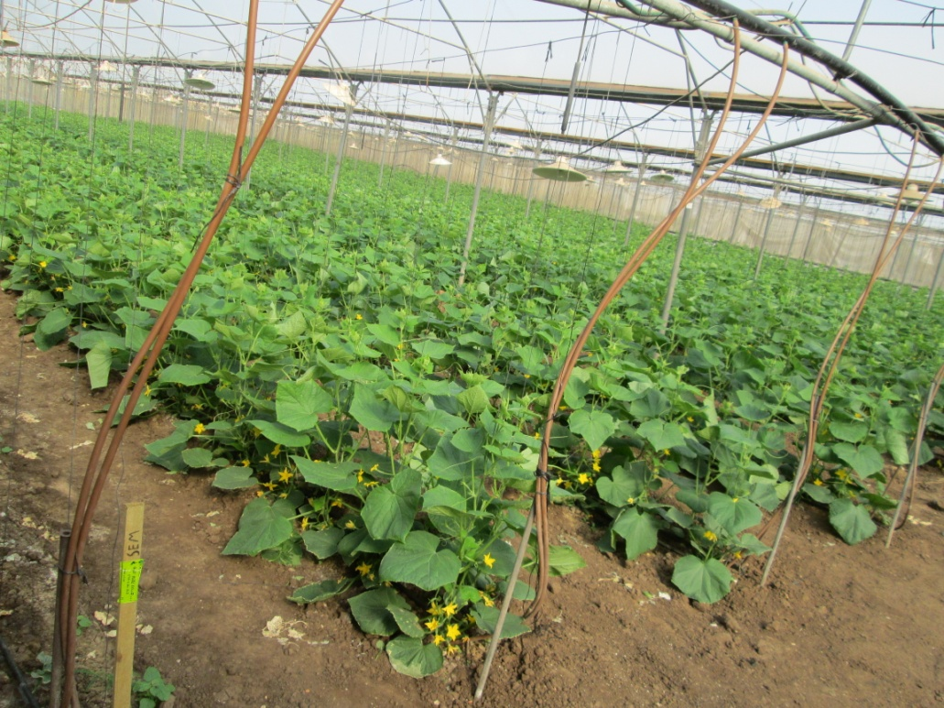
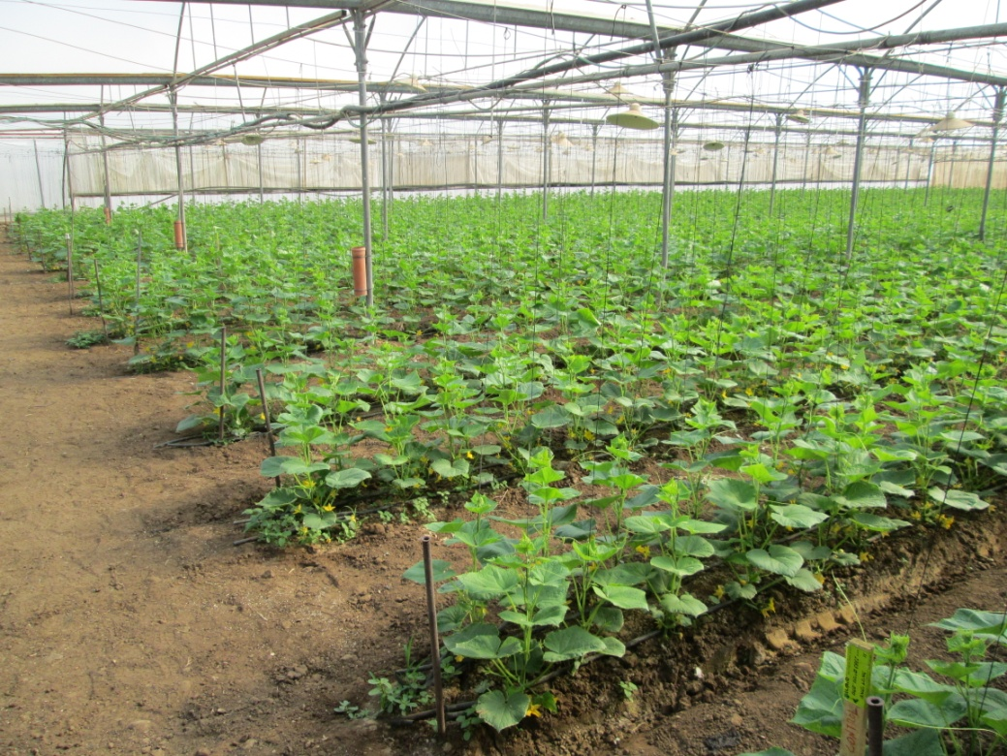
3 WEEKS AFTER TRANSPLANTING
SEM
CONTROL

Slide 7
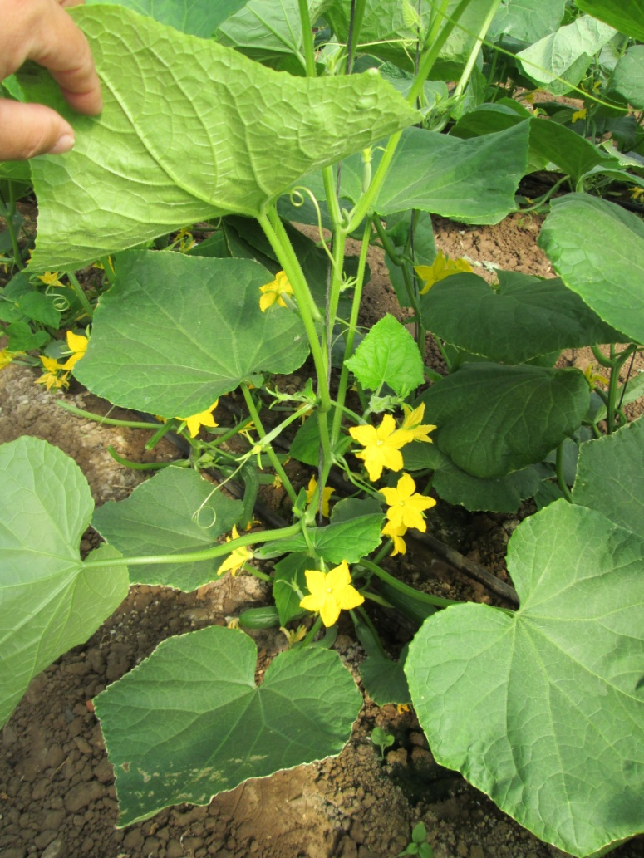
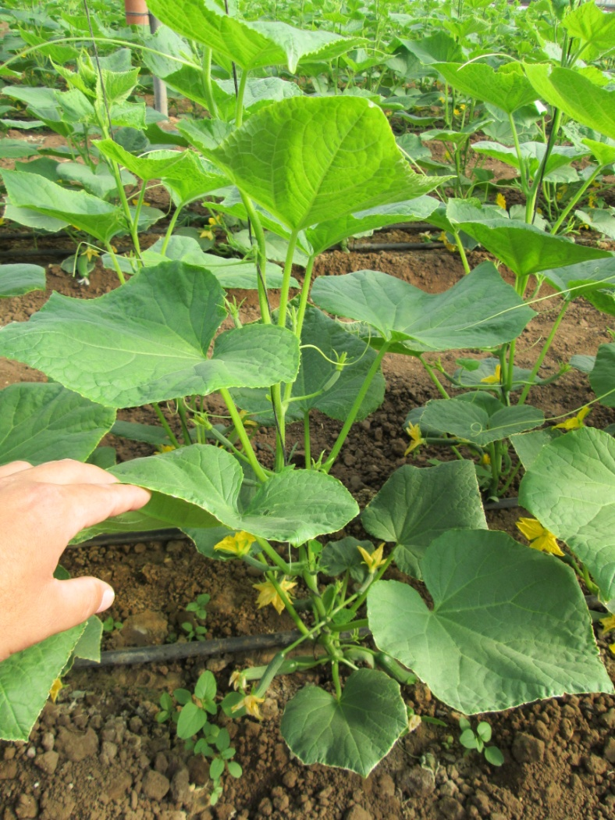
BEFORE HARVEST
SEM
CONTROL

Slide 8
YIELD DATA
Yield(KG) Per plant |  | Difference(KG) (KG per plant) | Difference in %
Control Field | SEM Treated field
2.34 | 2.90 | 0.56 | 24%

Slide 9
Yield Data

Slide 10
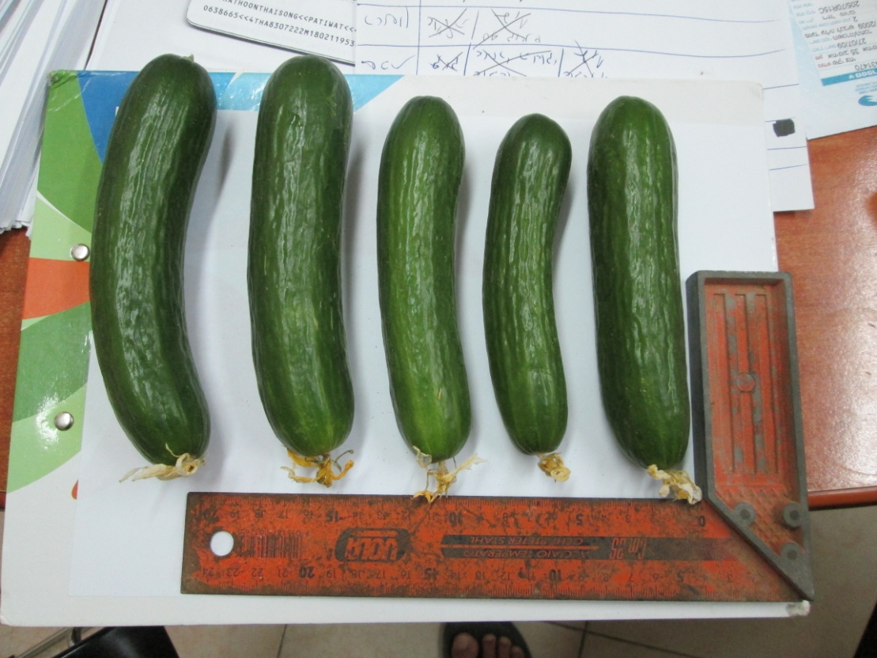
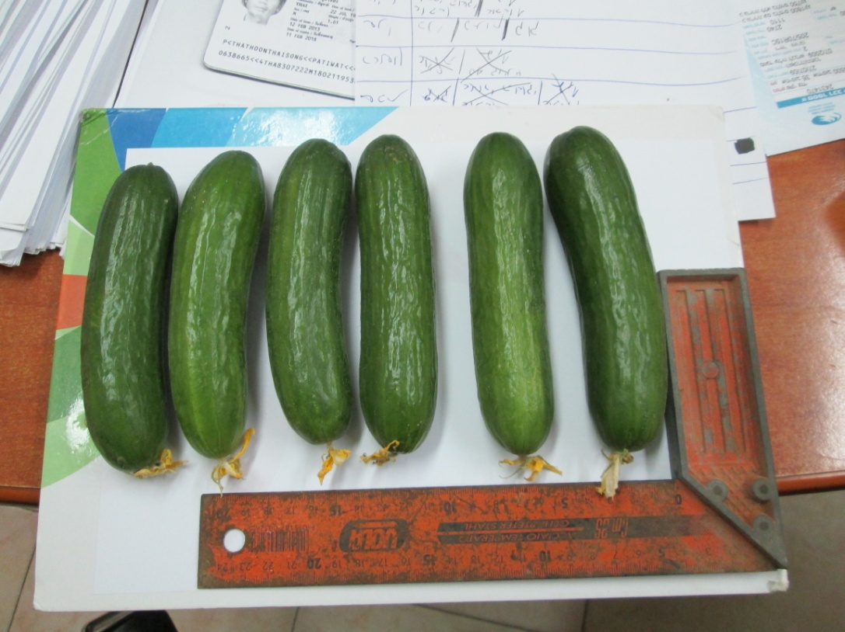
Post Harvest Shelf lifeT-0
Saiseiko SEM series
Control

Slide 11
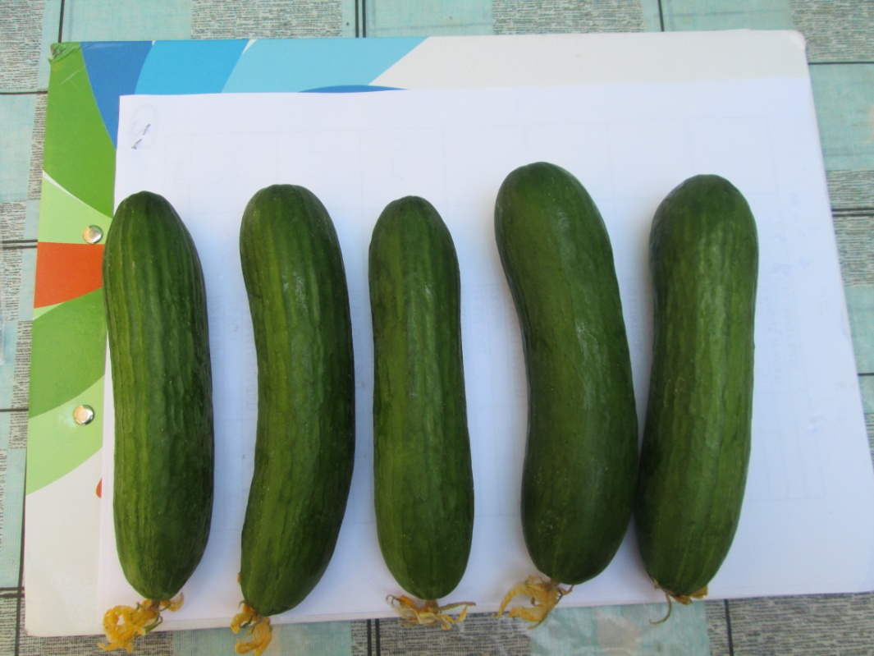
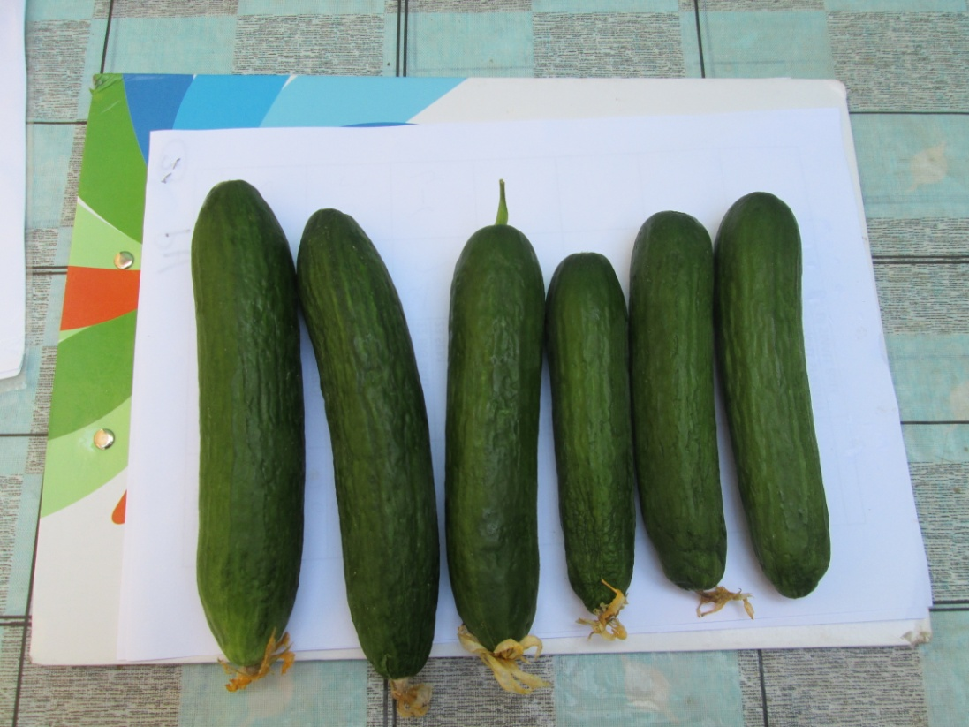
Post Harvest Shelf life After one WEEK
SEM
CONTROL

Slide 12
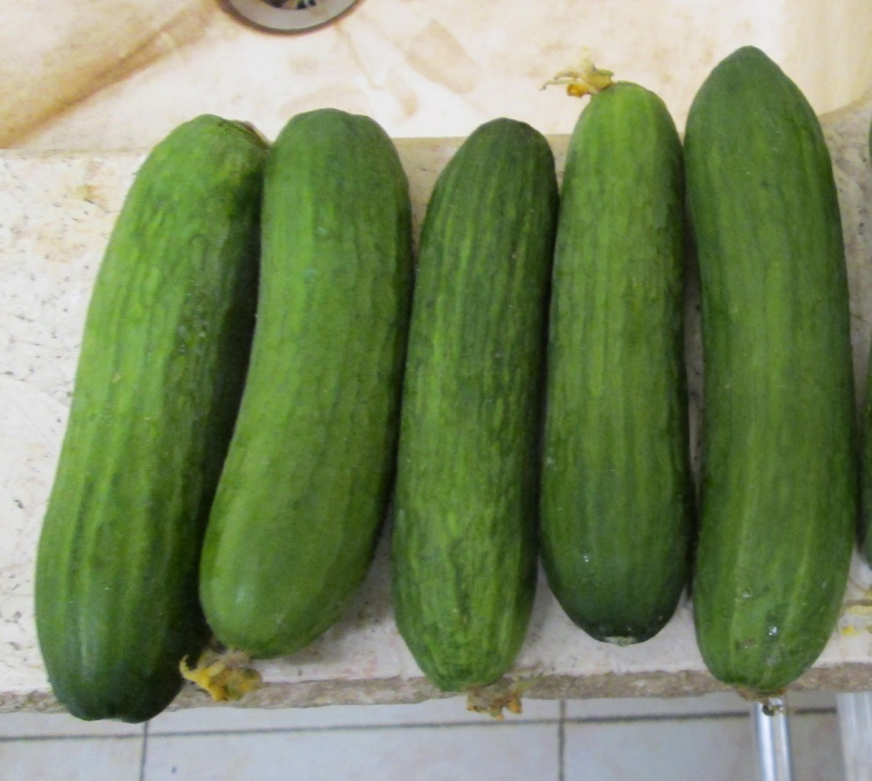
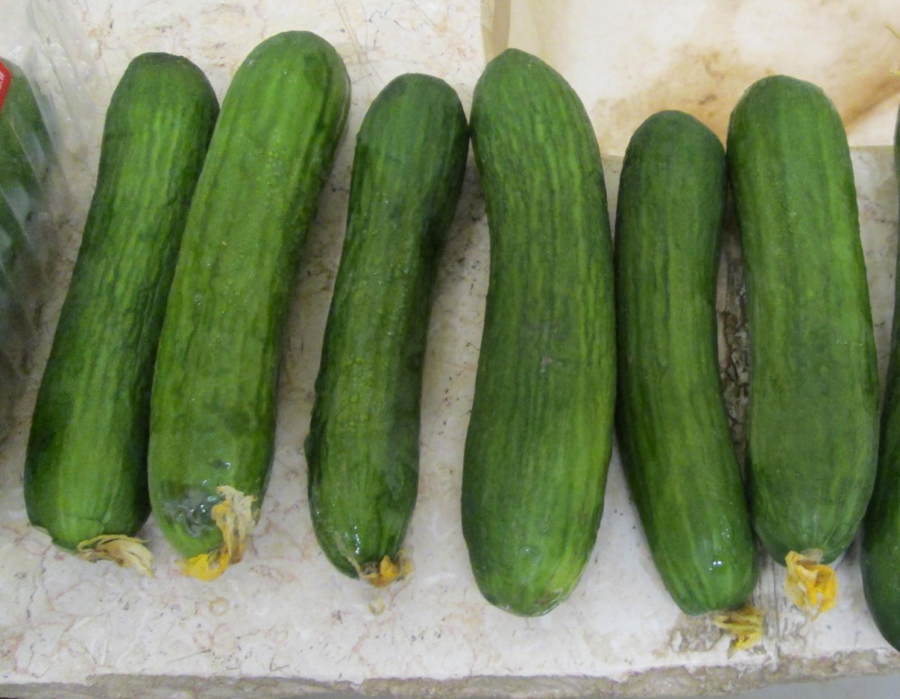
Post Harvest Shelf Life After two weeks
Saiseiko SEM Series
Control

Slide 13
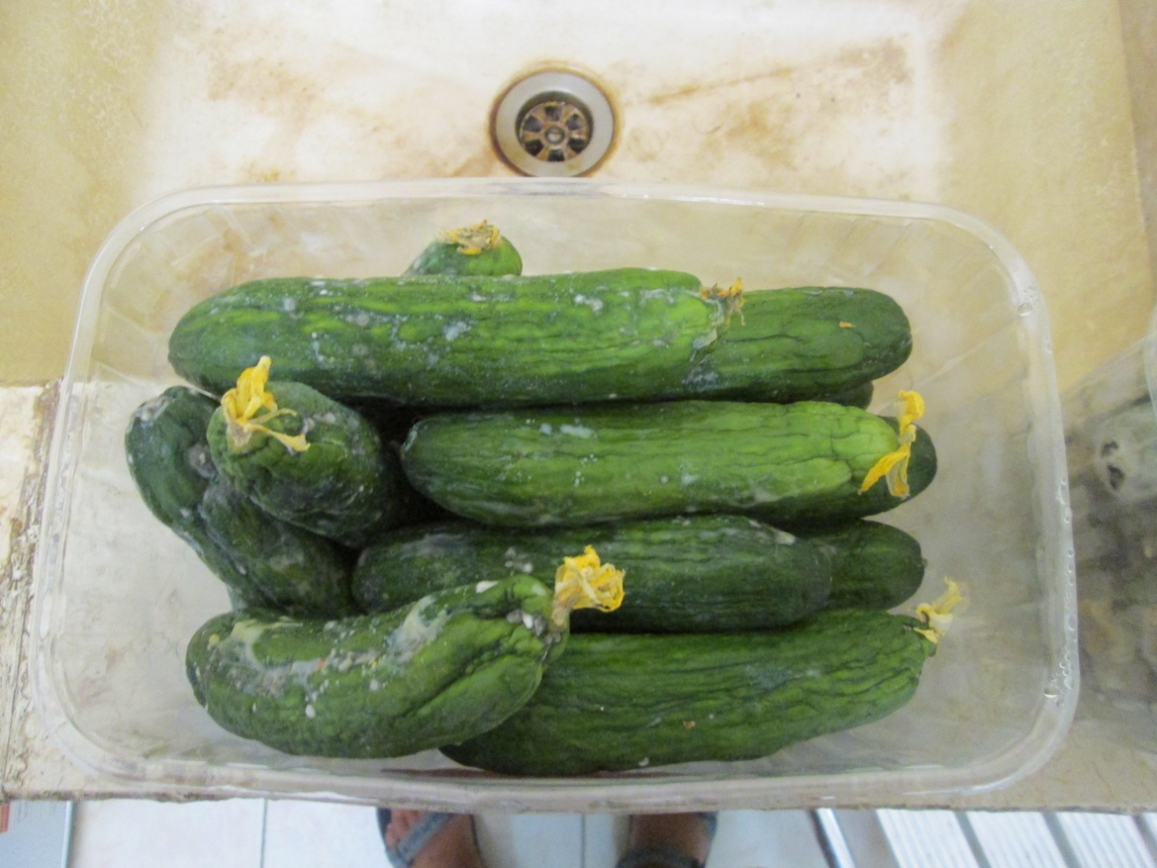
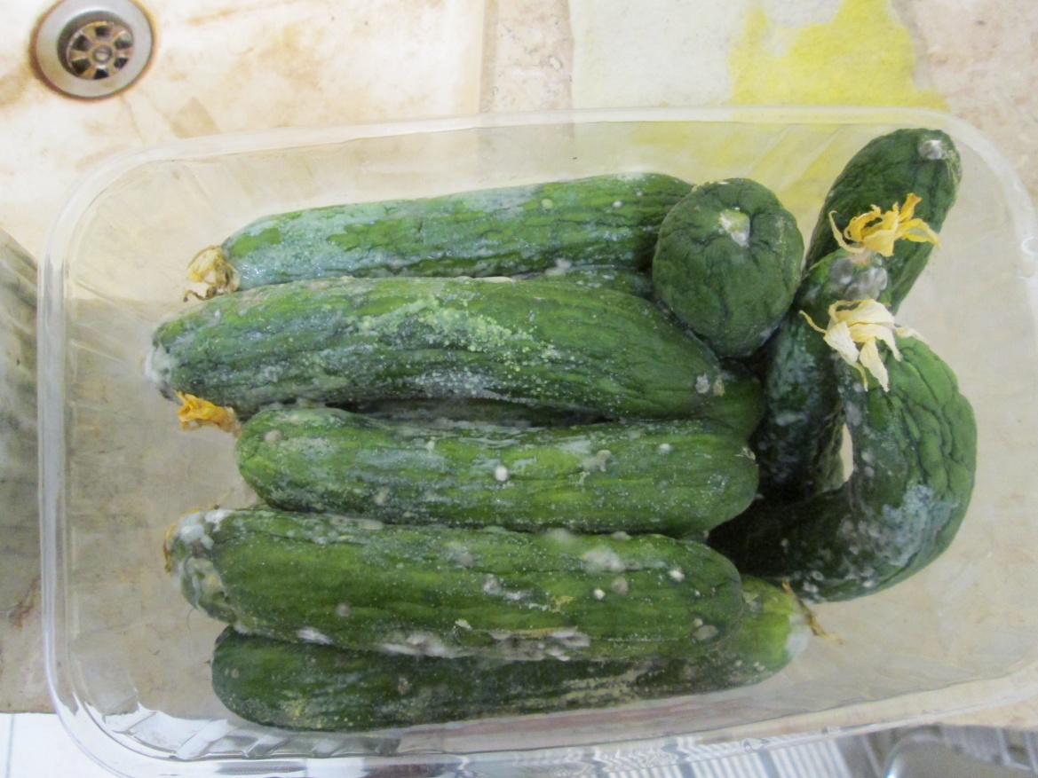
Post Harvest Shelf Life After three weeks
Saiseiko SEM Series
Control

